Slide 1

METS in heterogeneous digital repositories
Robert Sharpe, Operations Director

Slide 2
Agenda
Preservica: Digital Preservation Product
Types of metadata
Variable metadata schemas
Why is this is a problem?
Our Solution
Advantages & disadvantages
Conclusions

Slide 3










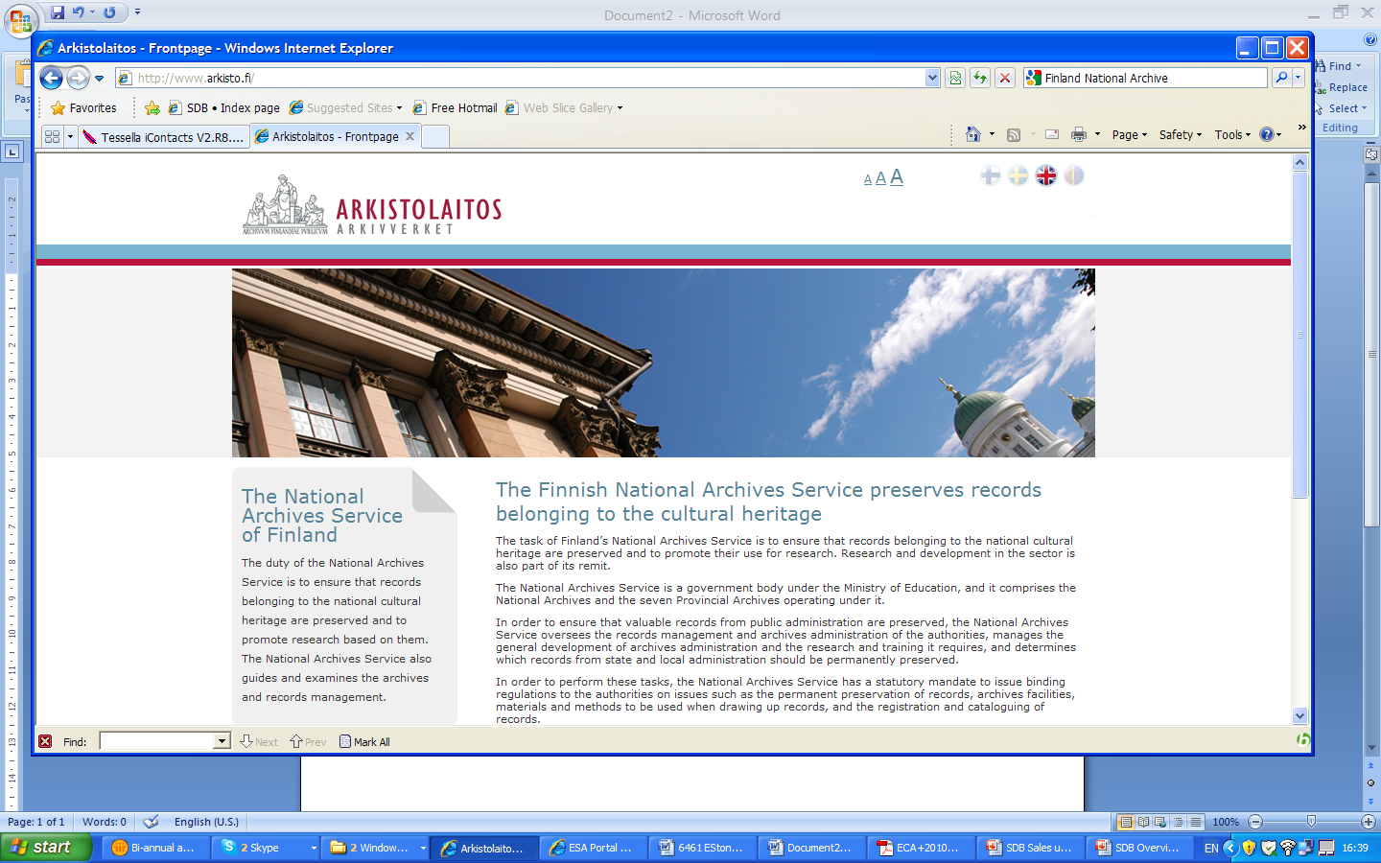



















Preservica: World Leading Digital Preservation
National & Pan-National
Libraries & Museums
UK National Archives
Malaysian Archives
Museum of Fine Arts Houston
European Commission
Dutch National Archives
Swiss Federal Archives
Austrian Archives
Finnish National Archives
Latvian National Archives
National Archives of Hungary
Estonian National Archives
Emerson College
Bates College
State of Vermont Archives
Corporate Archives
Archives of Michigan
Rotterdam City Archive
UK Met Office
UK Parliament
Budapest City Archive
Dorset
State & Government
Business & Corporate

Slide 4
Types of metadata
Structural:
Need for browsing, search & discovery
Can set context
Can be important in preservation:
In fact generally discover more structure
Descriptive:
Need for search & discovery
Sets context
Can inform policy (e.g., retention schedules)
Technical:
Generally extracted
Need for preservation

Slide 5
Variable metadata schemas
Domain:
Libraries METS, MODS etc.
Archives EAD, Dublin Core
Other anything
National government schemas:
Switzerland ARELDA
Finland SAHKE2
Austria EDIAKT (now EDIDOC)
Individual source schemas:
Different record management systems
Digitisation programs
Web archiving
etc.

Slide 6
Why is this a problem?
Often people think need 1 single schema
Not really necessary:
Anyway all schemas change
Don’t want to change system for any and every change
But we do need:
Understand basic structural & descriptive information:
e.g., something to show in summaries while browsing
Ability to view / edit / search all structural & descriptive information:
But doesn’t have to all be in single schema
Detailed technical metadata:
But we create this within system

Slide 7
Our Solution 1/2
Use our own schema, XIP
OAIS SIP/AIP/DIP
Not a standard but fully documented
Designed to be automated and fast
It covers:
Basic structural & descriptive information
Detailed technical information
Preservation planning & actions (Transformations etc..)
Embeds:
Detailed structural & descriptive information
In any XML schema
Schema(s) can vary as needed

Slide 8
Our Solution 2/2
Index any (all) metadata fields:
Can do all field searching
Can do fielded searching (choose type first)
Use XSLT to:
View metadata
Edit metadata
Transform metadata (or hierarchy of schemas)
Can store metadata snapshot:
Transform as needed
Can export:
Transform as needed
e.g., Export as METS with MODS and PREMIS

Slide 9
Advantages
Can cope with any choice of ingest schema
Can cope with any choice of storage schema
Can cope with any choice of export schema
One system supports many types of customer
Impedance to ingest from a new system reduced:
Alternative is to wait for complex metadata mapping
Resilient to schema changes:
No need to migrate system to new version of schema

Slide 10
Disadvantages
More complex fielded searching:
Can put in single schema if want to
But software doesn’t require you to!
Need to create viewers / editors:
Have a set now for common schemas
Basic viewers show any metadata
Look and feel of viewers / editors:
However, more resilient to change

Slide 11
Conclusions
From our perspective, METS is:
One potential ingest schema (for some information)
One potential storage schema (for some information)
One potential export schema (for some information)
While we can be flexible, don’t want myriads of schemas
One schema can’t do everything:
Not should it
Need to know how to combine schemas:
Need guidelines (e.g., METS & PREMIS)

